Slide 1



Slide 2


Slide 3
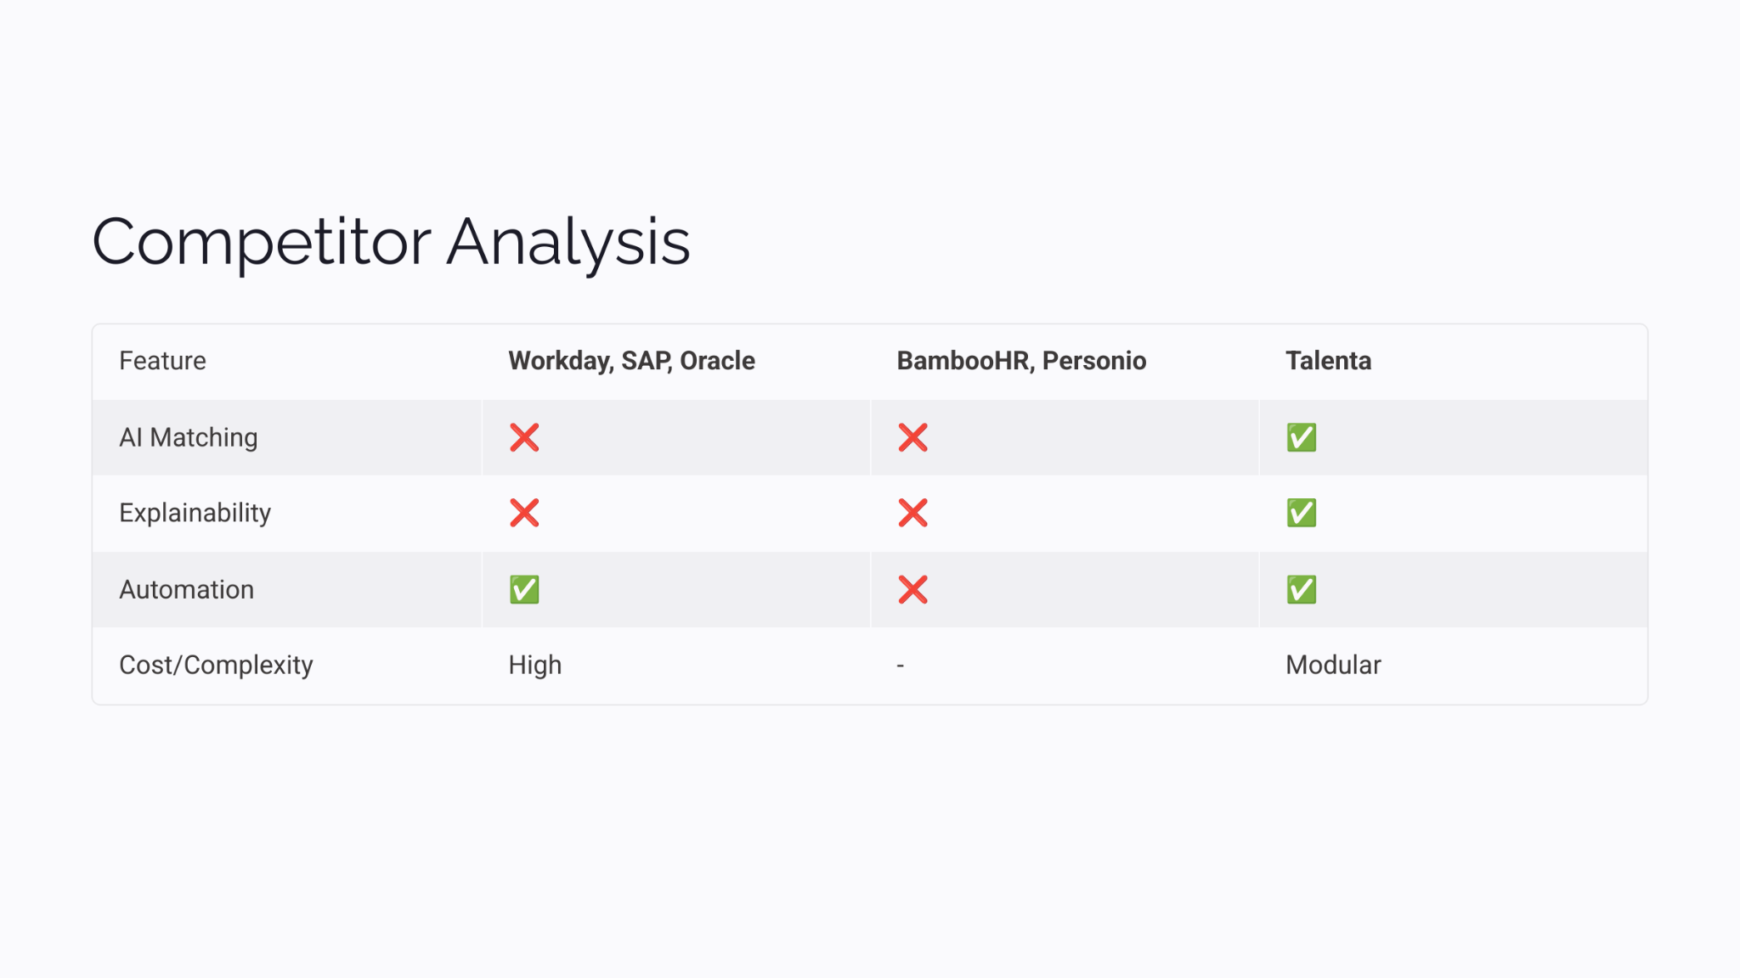

Slide 4


Slide 5
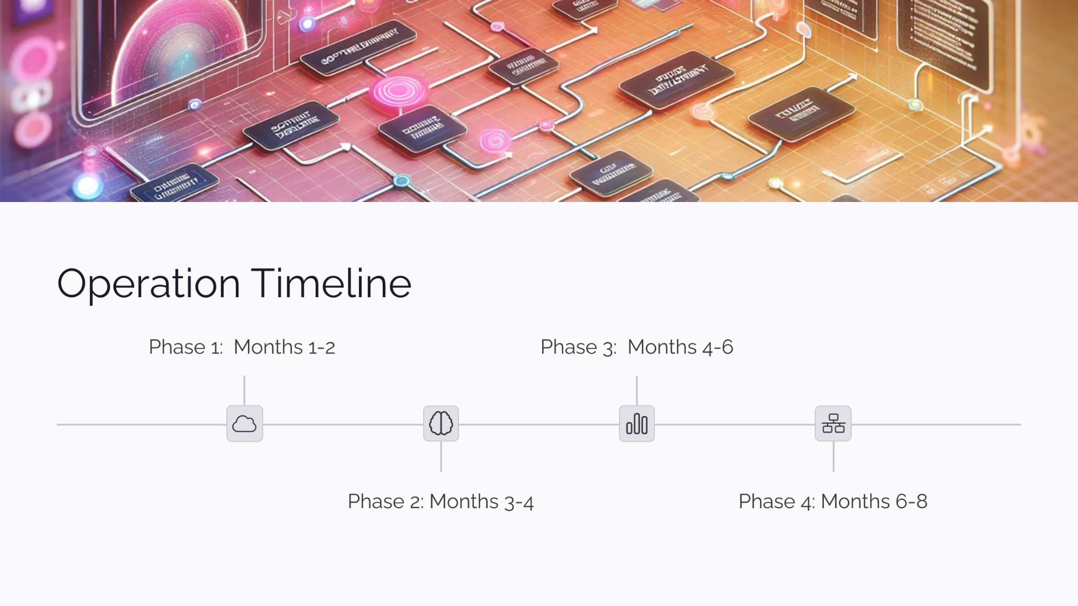
Go live
RLHF

Slide 6
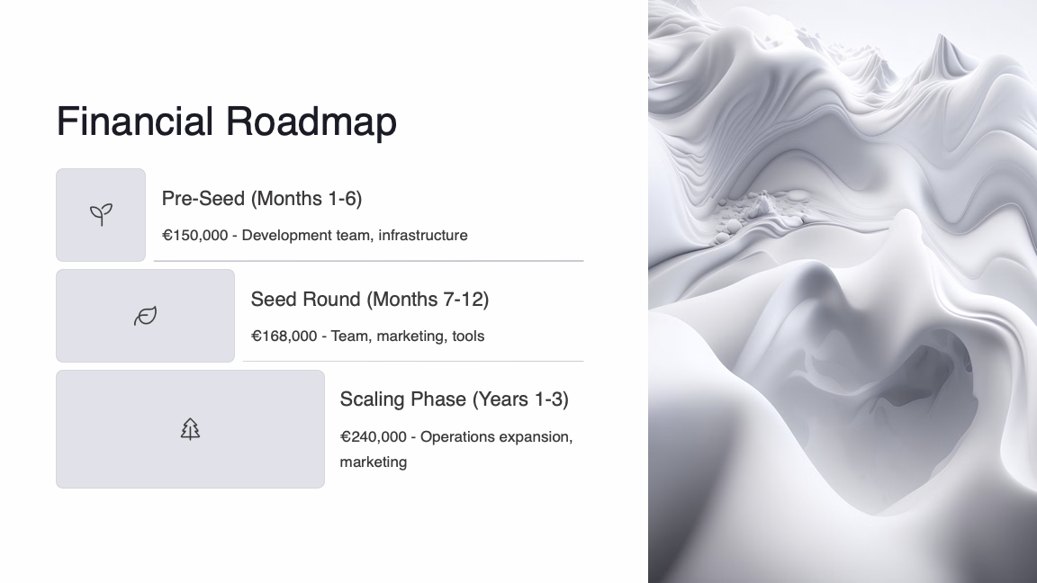

Slide 7
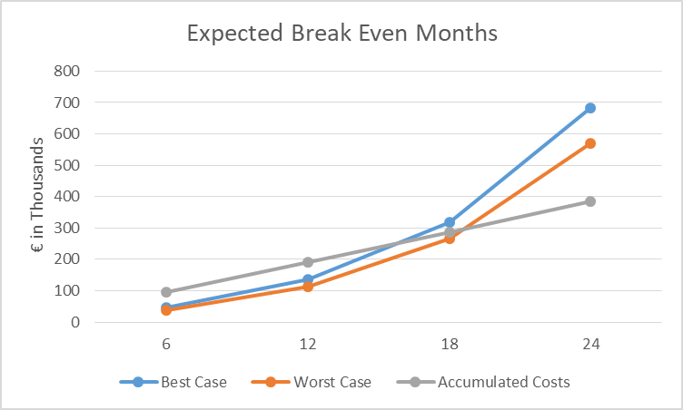

Slide 8
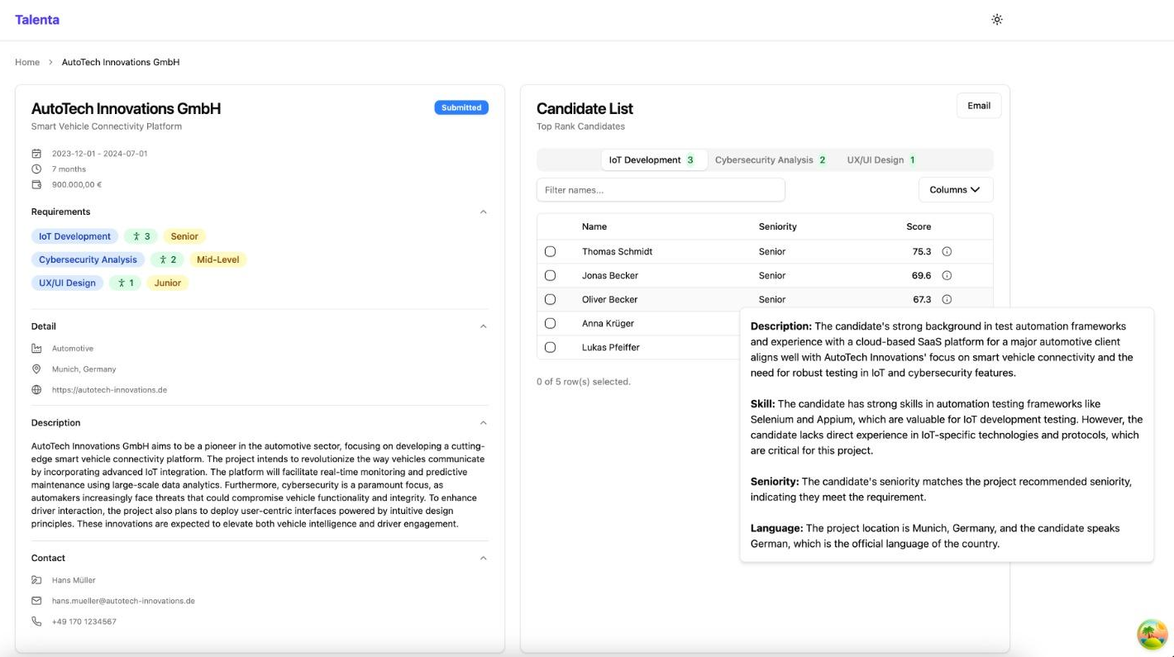

Slide 9
Monthly Pricing Model
Basic | Professional | Enterprise
€500 | €1200 | €1800

Slide 10





Team
D Hema Kumar
Sreehari Pradeep Kumar
Jordi Bernandi
Hsien-Yi Wang
Zirui Guo

Slide 11
Thank You

